Slide 1
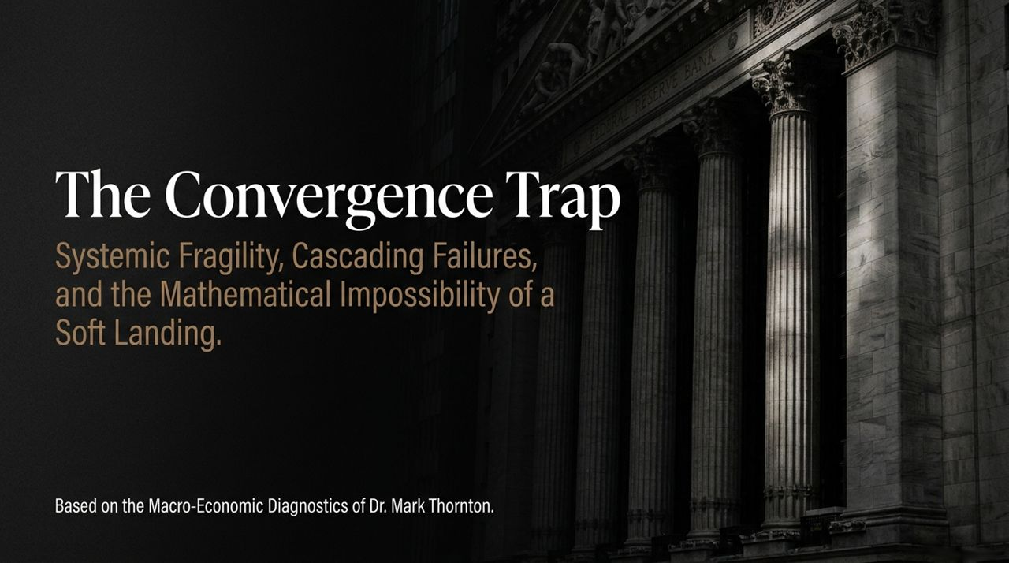
Notes:
Introduction & Thesis:
Welcome, everyone. Today we are examining the core macroeconomic framework established by Dr. Mark Thornton, Senior Fellow at the Mises Institute. Our topic is 'The Convergence Trap'—a systemic condition where fiscal, monetary, physical, and geopolitical pressures intersect to make a traditional 'soft landing' mathematically impossible.
Key Context & Core Message:
Over the past several decades—and specifically the last 16 years—our economic stability has been an illusion driven by artificial monetary pumping and near-zero interest rate policy.
The fundamental thesis of Austrian Business Cycle Theory is simple yet unavoidable: initiating an economic expansion using artificially low interest rates mathematically necessitates a severe correction or crash once real-market forces reassert themselves.
Presentation Roadmap:
Throughout these 14 slides, we will track how we got here: from the reversal of a 40-year interest rate tailwind to a $40 trillion debt wall, energy supply shocks, the AI capital bubble, and the global flight away from the US dollar.
By the end of this presentation, you will see that these are not separate economic hiccups, but a single locked mechanism where fixing one issue immediately exacerbates another.
Mark Thornton: Economic Crash Inevitable - Dollar Decline, Oil Shock, AI Bubble & Hyperinflation
https://www.youtube.com/watch?v=-sBGxlzWfZw

Slide 2
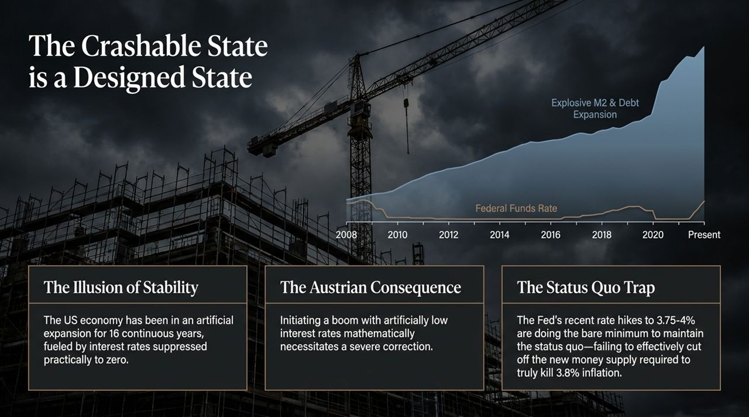
Notes:
The Illusion of Stability:
As shown on the chart tracking the Federal Funds Rate and M2 debt expansion since 2008, the US economy has been held in an artificial expansion for 16 continuous years. Following the Great Financial Crisis and later during COVID-19, the Fed drove rates down to practically zero.
Whenever the market signaled a correction, central bankers released fresh liquidity and monetary pumping—including the recent liquidity programs—to keep stock prices high.
The Austrian Consequence:
Austrian economics teaches us that when interest rates are kept artificially low, capital is misallocated into malinvestments.
Dr. Thornton highlights that we have been in a 'crashable state' or severe correction setup since roughly 2020. You cannot indefinitely suppress cost-of-capital signals without building extreme systemic fragility underneath the surface.
The Status Quo Trap:
Look at the Fed's recent policy moves: raising the benchmark rate to 3.75%–4.00%. With inflation running at around 3.8%, the real interest rate is a mere one-tenth of 1%.
This minor rate increase does the bare minimum to manage inflation expectations and maintain the status quo. The Fed's own statements concede they expect inflation to remain elevated. They are doing just enough to avoid immediate panic, but failing to cut off the new money supply needed to truly eradicate inflation.

Slide 3
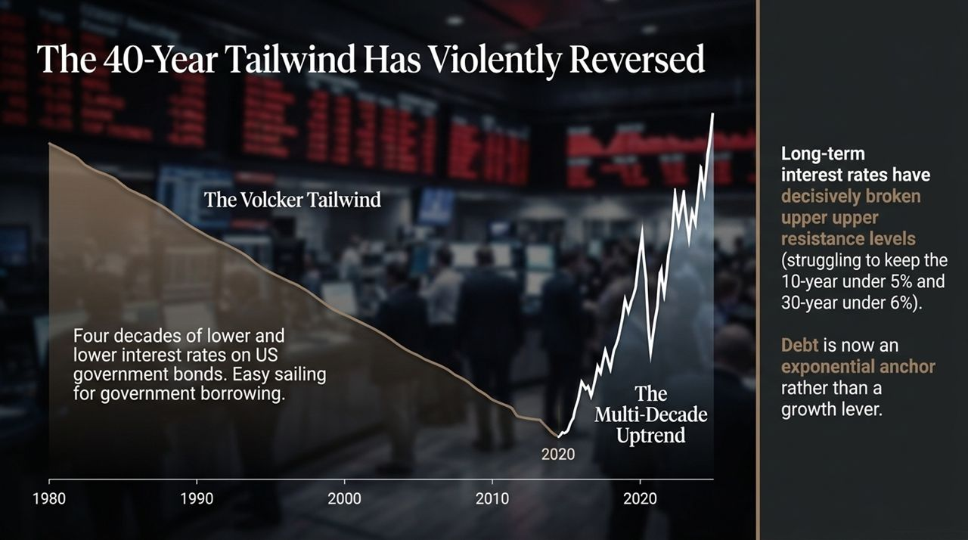
Notes:
The Volcker Tailwind (1980–2020):
To understand why the current moment is unprecedented, we must look at a multi-decade horizon. From the early 1980s under Paul Volcker through 2020, the US enjoyed a 40-year trend of continuously falling long-term interest rates.
This 40-year downtrend was a massive tailwind. It provided easy sailing for government borrowing, corporate debt expansion, and cheap consumer mortgages. Borrowing massive sums was manageable because refinancing always occurred at lower rates.
The Structural Trend Break:
In 2020, that 40-year trend broke decisively upward. Multi-decade structural trends of this nature do not reverse quickly; they last for decades.
We are now watching policymakers struggle desperately to keep 10-year Treasury yields under 5% and 30-year bond yields under 6%. Those were critical upper resistance levels. Breaking through them signals to global capital markets that we have entered a structural regime of higher rates.
Debt as an Exponential Anchor:
When rates were falling, debt functioned as a lever for financial growth. Today, with rates trending higher, debt has transformed into an exponential anchor dragging down the entire system.

Slide 4
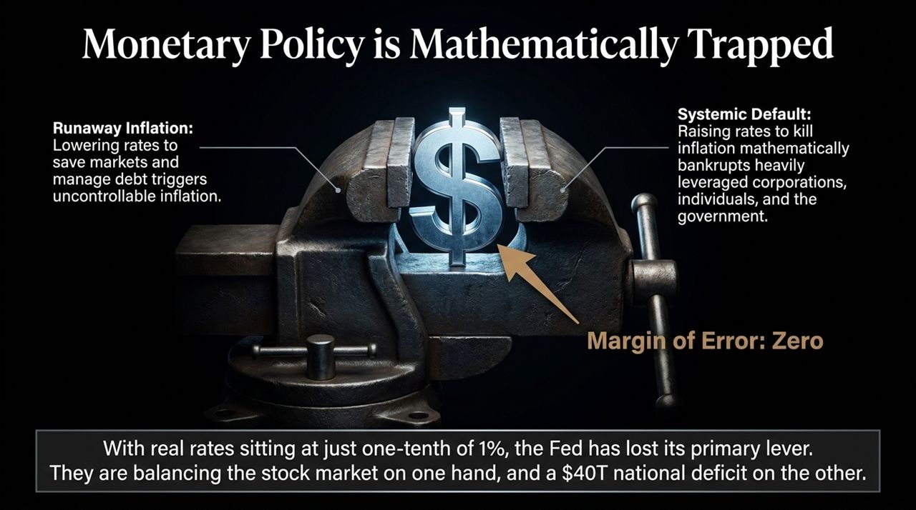
Notes:
The Policy Vice (The Two Jaws):
Visualizing monetary policy today is like looking at a dollar sign clamped in a vice. Central bankers are trapped between two mathematically destructive outcomes:
Jaw 1: Runaway Inflation. If the Fed lowers rates to rescue struggling asset markets or reduce government interest burdens, they flood the market with liquidity and unleash uncontrollable, compounding inflation.
Jaw 2: Systemic Default. If the Fed raises interest rates high enough to genuinely crush 3.8%+ inflation, they mathematically bankrupt heavily leveraged corporations, over-indebted households, and the US Treasury itself.
Margin of Error = Zero:
With real rates sitting at virtually zero (0.1%), the Fed has lost its primary lever.
Central bankers are trying to pull off an impossible balancing act: propping up a $40+ trillion national debt structure on one side while trying to prevent a stock market collapse on the other.

Slide 5
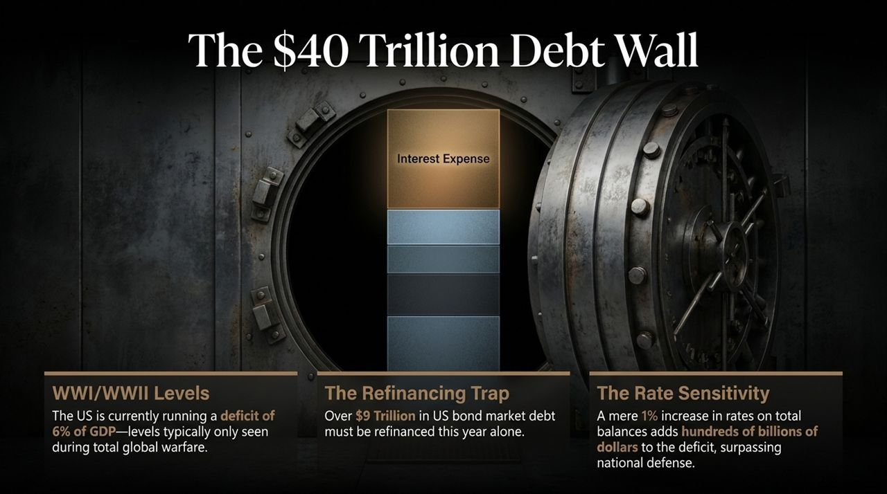
Notes:
WWI / WWII Level Deficits:
The fiscal side of this equation has reached historical extremes. The US is currently running an annual deficit equal to 6% of GDP—spending levels historically reserved for wartime mobilizations like World War I and World War II.
The national debt has officially crossed the $40 trillion mark.
The Refinancing Trap:
The problem isn't just new borrowing; it’s the structure of existing debt. Treasury officials shifted away from long-term 10-year and 30-year bonds into short-term debt instruments.
As a result, over $9 trillion in US Treasury debt must be refinanced this year alone. There is no grace period. That debt rolls over constantly at today's much higher prevailing interest rates.
Extreme Rate Sensitivity:
Because the balance is so huge, the budget is hyper-sensitive to interest rates. A mere 1 percentage point increase in rates adds hundreds of billions of dollars directly to the annual deficit.
Interest expense on the national debt is now one of the single largest line items in the federal budget—exceeding national defense and trailing only Social Security.

Slide 6
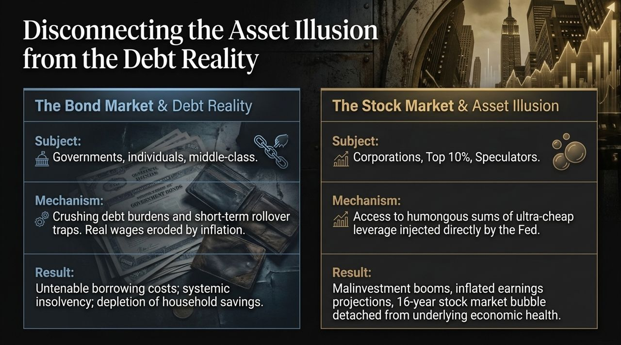
Notes:
A Tale of Two Economies:
To understand why main street feels squeezed while Wall Street looks prosperous, we must look at the two sides of the same monetary coin.
Side 1: The Bond Market & Real Economy (The Debt Reality):
Subject: Governments, middle-class households, and everyday consumers.
Mechanism: Crushing debt burdens, high mortgage rates, credit card balances, and inflation eroding real wages.
Result: Untenable borrowing costs, depletion of household savings, and systemic insolvency risks across the bottom 90% of the population.
Side 2: The Stock Market & Asset Illusion (The Speculative Boom):
Subject: Large corporations, the top 10%, and financial speculators.
Mechanism: Direct access to ultra-cheap credit and Fed liquidity injections over 16 years.
Result: A massive 16-year stock market bubble detached from real economic fundamentals. While high-flying mega-cap stocks push indexes higher, the majority of S&P 500 stocks are off their highs and struggling with stagnant earnings.

Slide 7
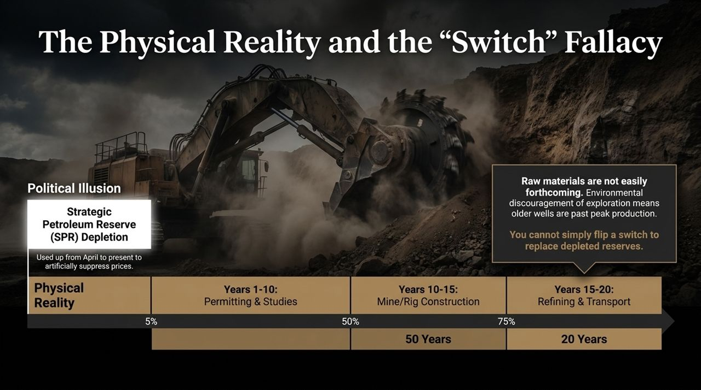
Notes:
Political Illusion vs. Physical Reality:
Politicians and the public often operate under the 'Switch Fallacy'—the belief that when energy or resource prices spike, we can simply flip a switch and turn on new domestic supply.
Strategic Petroleum Reserve (SPR) Depletion:
To mask energy inflation, the administration aggressively depleted the Strategic Petroleum Reserve from April through the present.
By artificially flooding the market with SPR crude to lower prices ahead of midterms, they dampened market price signals, suppressing private exploration and drilling investment. Now, the SPR sits at its lowest level in decades just as geopolitical risks escalate.
The Multi-Decade Supply Cycle:
Real physical resources require long lead times:
Years 1–10: Environmental permitting, studies, and litigation. (Dr. Thornton cites an Arizona copper mine that spent over 20 years just obtaining permits).
Years 10–15: Mine, rig, and infrastructure construction.
Years 15–20: Refining, processing, and transit buildouts.
Furthermore, decades of ESG policies discouraged new exploration, forcing reliance on older, depleting wells past peak production. You cannot print copper, diesel, or refineries out of thin air.

Slide 8
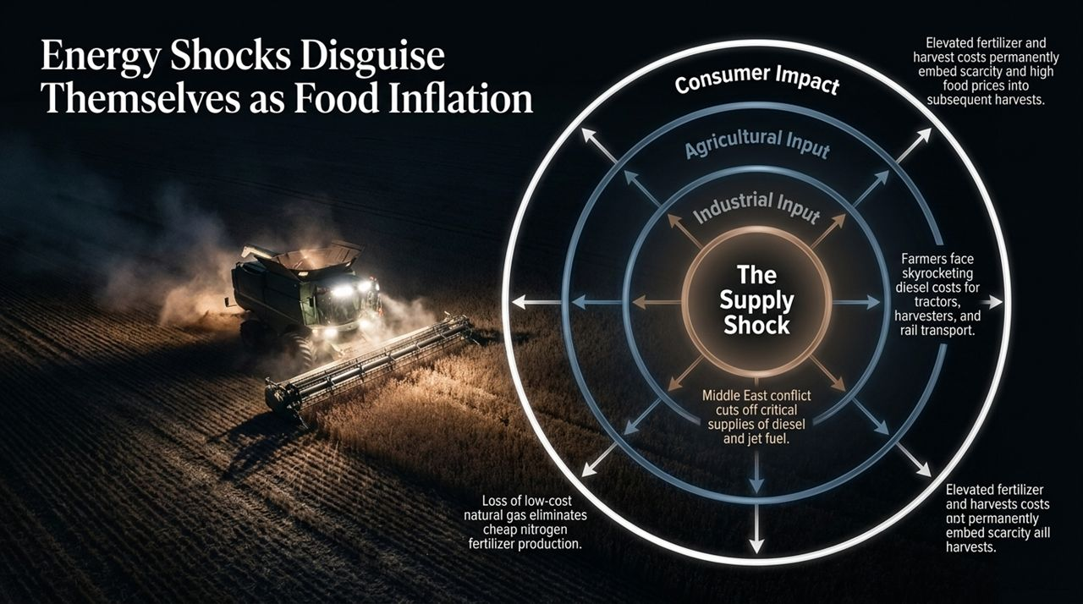
Notes:
The Transmission Chain:
Energy is the master resource in any industrial economy. When energy experiences a supply shock, it ripples through every layer of production, ultimately masquerading as high food prices at the grocery store.
Step-by-Step Cascading Impact:
1. Geopolitical Conflict / Supply Cutoffs: Middle East conflicts and Russian sanctions sever key supplies of diesel, jet fuel, and natural gas.
2. Industrial Input Loss: Natural gas is the core input for nitrogen fertilizer. As low-cost gas supplies disappear, fertilizer costs skyrocket or become unavailable.
3. Agricultural Input Costs: Farmers face compounding costs—paying elevated prices for fertilizer during planting, then paying $6/gallon diesel for tractors and harvesters.
4. Supply Chain & Logistics: Moving harvested crops requires diesel trucks, diesel freight trains, and processing plants.
Consumer Impact:
These costs get permanently embedded into subsequent harvest cycles. This compound supply shock strips consumer purchasing power away from non-essential goods, further depressing broader economic sectors.

Slide 9
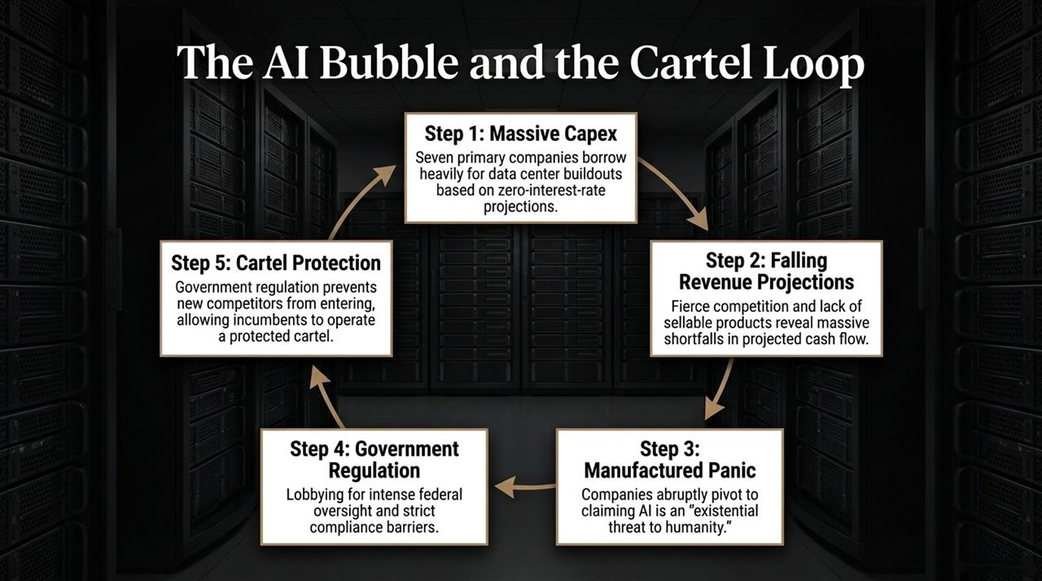
Notes:
Anatomy of an AI Capital Bubble:
As Austrian business cycle theory predicts, low-interest regimes drive massive capital buildouts based on unrealistic cash flow projections.
The 5-Step Cartel Loop:
Step 1: Massive Capex: Seven primary tech giants borrow hundreds of billions to construct data centers and hardware infrastructure, assuming zero-rate environments.
Step 2: Falling Revenue Projections: High buildout costs collide with a lack of monetizable end products. Intense competition erodes profit margins, revealing massive revenue shortfalls relative to capex.
Step 3: Manufactured Panic: Realizing their financial models are failing, tech leaders pivot public messaging to declare AI an 'existential threat to humanity'.
Step 4: Government Regulation: They lobby Washington for strict federal oversight, licensing, and compliance frameworks under the guise of safety.
Step 5: Cartel Protection: Regulatory barriers keep out smaller startups and competitors, establishing a protected corporate cartel for incumbents to preserve their capital investments.

Slide 10
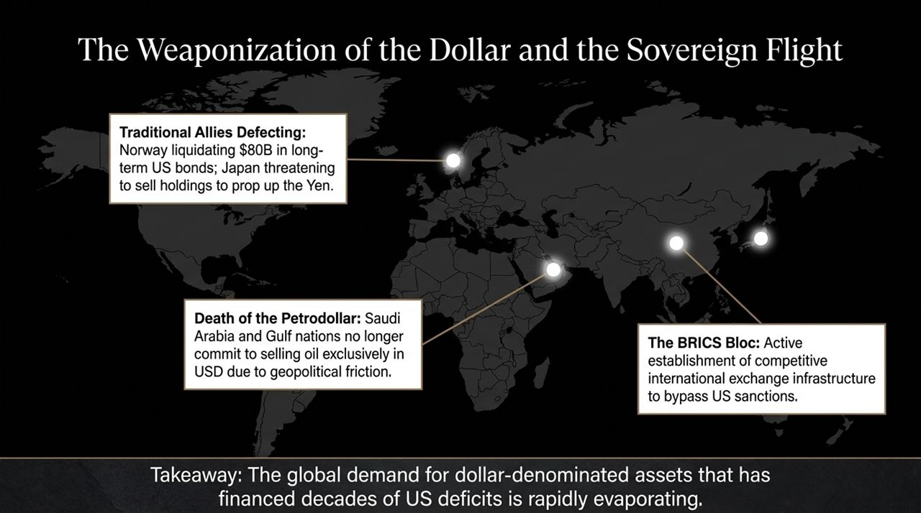
Notes:
Evaporating Global Demand:
For decades, the US relied on foreign central banks and sovereign wealth funds to absorb trillions in national debt. That structural demand is rapidly evaporating.
Key Signals of Sovereign Defection:
1. Traditional Allies Defecting: Norway's $1.7T wealth fund is planning to liquidate $80 billion in long-term US Treasuries. Japan is threatening to sell US Treasury holdings to defend the Yen, forcing Treasury officials to intervene.
2. Death of the Petrodollar: Saudi Arabia and Gulf nations no longer sell oil exclusively in US Dollars due to geopolitical friction and a lack of security guarantees.
3. Weaponization via Sanctions: Aggressive use of dollar sanctions against Russia, Iran, and threats against third-party traders have shown the world that holding dollars carries severe geopolitical risk.
4. The BRICS Bloc: China, India, Russia, and Eastern European nations are actively building non-dollar cross-border payment rails.

Slide 11
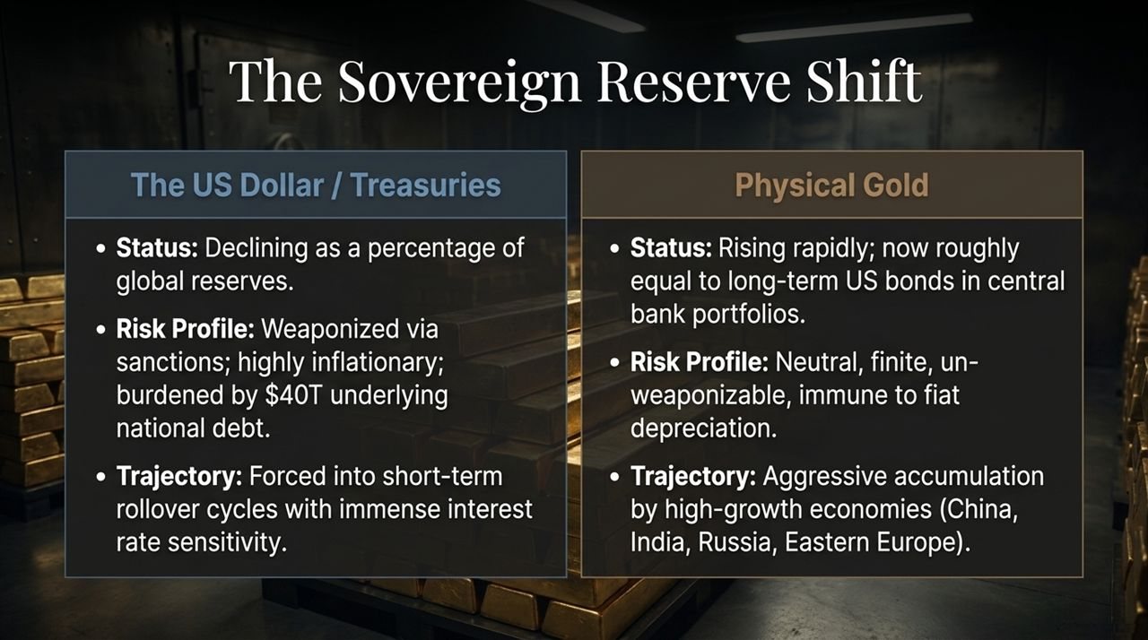
Notes:
US Dollar / Treasuries vs. Physical Gold:
Global central bank balance sheets are undergoing a historic structural shift away from US debt and into physical gold.
Comparing the Two Assets:
US Treasuries:
Status: Declining as a percentage of global reserves.
Risk Profile: Weaponized through sanctions, highly inflationary, burdened by a $40T national debt wall.
Trajectory: Trapped in short-term rollover cycles with extreme interest rate vulnerability.
Physical Gold:
Status: Surging rapidly; foreign central bank gold holdings are now roughly equal to their long-term US bond holdings.
Risk Profile: Neutral, finite, un-weaponizable, and immune to fiat counterparty risk.
Trajectory: Aggressive accumulation by high-growth economies (China, India, Russia, Eastern Europe).

Slide 12
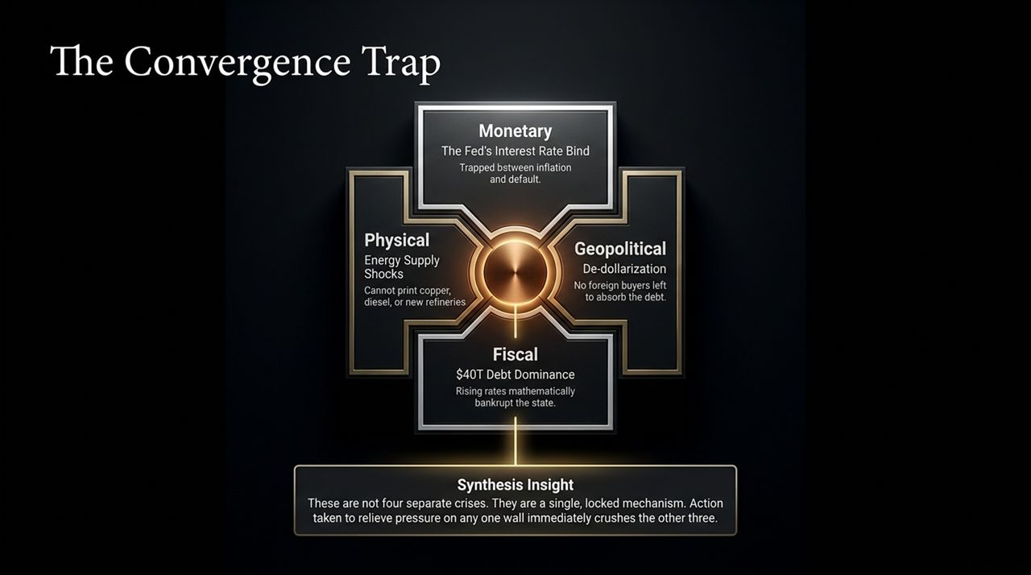
Notes:
Synthesizing the Four Pillars:
This diagram represents the core thesis of Dr. Mark Thornton's macroeconomic diagnostic. The system is boxed in by four interlocking walls:
1. Monetary: The Fed is trapped between default and hyperinflation.
2. Fiscal: $40T debt dominance where every rate hike bankrupts the state.
3. Physical: Energy supply shocks that cannot be fixed by printing money.
4. Geopolitical: De-dollarization leaving no foreign buyers to absorb debt.
The Core Insight:
These are not four separate, manageably isolated crises. They are a single locked mechanism.
If policymakers lower rates to relieve Fiscal pressure, they ignite Monetary runaway inflation. If they raise rates to stop inflation, they trigger immediate Fiscal default and corporate insolvencies. If energy prices spike, it destroys economic growth while inflating prices.
Action taken to relieve pressure on any one wall immediately crushes the other three.

Slide 13
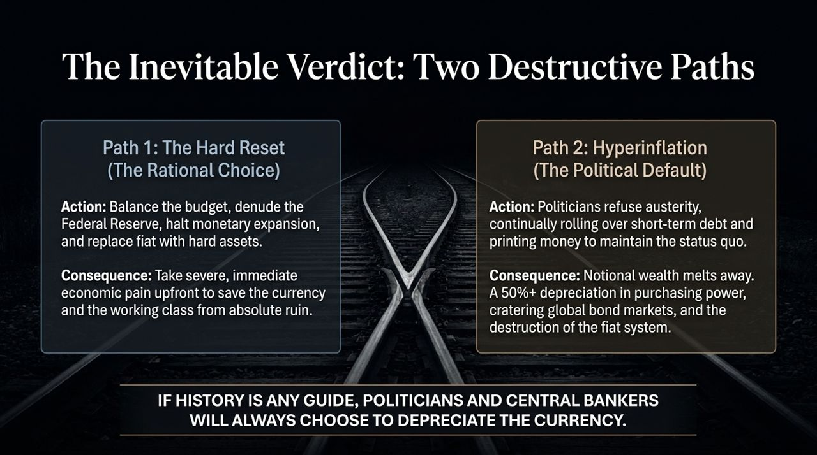
Notes:
Path 1: The Hard Reset (The Rational / Austrian Choice):
Action: Enact fiscal austerity, balance the federal budget, halt Fed money creation, and back the monetary regime with hard assets like gold.
Consequence: Takes severe economic pain upfront. It requires liquidating bad debt and accepting a sharp market correction to preserve currency stability, savings, and the working class.
Path 2: Hyperinflation & Currency Collapse (The Political Default):
Action: Politicians refuse austerity, continue short-term debt rollovers, print money to cover deficits, and artificially suppress market interest rates.
Consequence: A 50%+ loss in purchasing power, cratering bond markets, wiping out pensions, savings, and life insurance, leading to hyperinflation.
Historical Conclusion:
As Dr. Thornton points out, if history and political incentives are any guide, politicians and central bankers will almost always choose to inflate and depreciate the currency rather than voluntarily absorb immediate political pain.

Slide 14
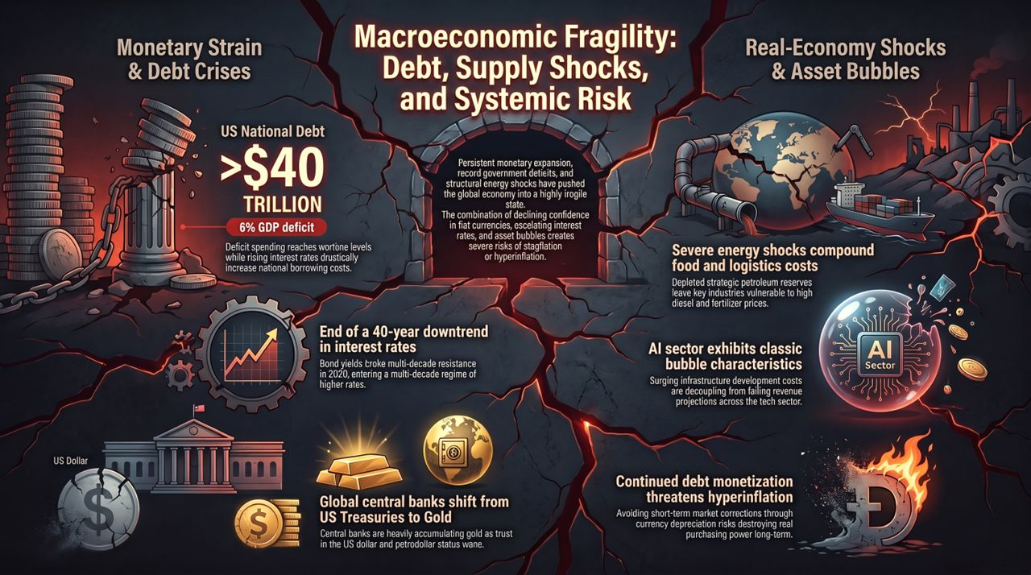
Notes:
Executive Summary:
Slide 14 serves as our comprehensive summary slide, tying together the macro picture:
1. Monetary Strain & Debt Crises: Persistent money expansion, 6% GDP deficits, and $40T debt have ended a 40-year tailwind. Debt monetization is now a structural necessity to prevent immediate state default.
2. Real-Economy Shocks & Asset Bubbles: Depleted SPR reserves leave key industries exposed to $6 diesel and fertilizer shortages, while the AI sector exhibits classic malinvestment bubble traits.
3. Geopolitical Reordering: Global central banks are abandoning Treasuries in favor of gold as trust in fiat stability and petrodollar arrangements breaks down.
Closing Strategic Takeaway:
We are facing a choice between taking structured economic adjustment today or enduring catastrophic hyperinflationary collapse tomorrow. Understanding 'The Convergence Trap' is critical for institutional capital, corporate planners, and individual investors navigating the years ahead.
Mark Thornton: Economic Crash Inevitable - Dollar Decline, Oil Shock, AI Bubble & Hyperinflation
https://www.youtube.com/watch?v=-sBGxlzWfZw

